Slide 1
Data Mind – {Logo+Punchline TM}

Slide 2
Class 4: Table of Contents
Data Science 101
Real life data Science project steps
Types of variables
Distributions – Normal, t distribution, Bernoulli
Hypothesis testing, Central limit theorem
Probability concepts, Bayes theorem
Supervised and un-supervised learning
Loss functions for continuous target variables
Loss functions for categorical target variables
Bias / Variance tradeoff (Overfitting and underfitting)
Missing Data Analysis - Imputation methods
Linear Algebra refresh
Bonus: Categorical variable representation via one-hot encoding, label encoder

Slide 3
Class 4: Typical Data Science project flow
Business Problem
(eg: decrease in footfall)
Feature engg.
Column wise
Row Wise
1. Define metrics (AUC,r-sq etc)
2. Validation strategy
1. Data availability
2. Define success criteria (most imp)
1. Outlier identification & treatment
2. Missing value treatment
Model creation & run
Evaluation
Improvement iteration
Unit testing + QC
1. Data collection
2. Data assimilation
Data quality report
(distribution, variable types, summary stats)
Client buy in via presentation ($ value)
Deployment on cloud
SIT and UAT
Hypothesis generation and testing
Visual Data Exploration
Model Maintenance & Improvement feedback

Slide 4
Class 4: Types of variables
Variable
Numeric
Continuous
Discrete
Categorical
Ordinal
Nominal

Slide 5
Class 4: Variable properties
Numeric Variables: Real Numbers
Continuous: Can take many values in between two ranges. Eg: Salary, Age
Discrete: Can only take discrete value (numeric though). Eg: count features.
Some literature also mentions, Ratio and Interval scale variables, but we will not look into those as they create more confusion and does not add value
Summary stats: Mean, median, mode, min, max, differences, spread, variance/std-dev
Categorical Variable: As name implies, has categories.
Ordinal: Categories are ordered and the order has meaning. Eg: Income high, medium, low; ranks
Nominal: Order less; Eg: colors Red, Blue, Green
Summary stats: Mode, median, Frequency distribution, cross tabs

Slide 6
Class 4: Hypothesis testing & CLT
What is hypothesis testing in inferential statistics –
Hypothesis testing is a method for us to understand which one out of null or alternate hypothesis stands a better change of being accurate given the data
More formally, hypothesis testing or significance testing is a method for testing a claim or hypothesis about a parameter in a population, using data measured in a sample. In this method, we test some hypothesis by determining the likelihood that a sample statistic could have been selected, if the hypothesis regarding the population parameter were true *
Why it is needed –
Hypothesis testing is the basis of data science and is very important to understand other concepts such as significance, variable selection, etc
Central limit Theorem:
The central limit theorem (CLT) is a statistical theory that states that given a sufficiently large sample size from a population with a finite level of variance, the mean of all samples from the same population will be approximately equal to the mean of the population. Furthermore, all of the samples will follow an approximate normal distribution pattern, with all variances being approximately equal to the variance of the population divided by each sample's size.
* https://www.sagepub.com/sites/default/files/upm-binaries/40007_Chapter8.pdf

Slide 7
Class 4: Hypothesis testing in Inference statistics
Why inferential statistics & key concepts:
We want to estimate ‘things’ about population. Eg: Avg math marks in CBSE exam for class X.
Population data is very costly to collect. So we collect random samples adhering to sampling best practices of:
Random samples
Representative of population
Stratified in relevant parameters
Selected without any inherent bias in selection procedure
Maintain minimum sample size for statistically valid inferences
Conduct experiments on sample to assert ‘things’ about population statistics
Null hypothesis: Status quo or lazy assumption
p-value: probability of null hypothesis being true and yet we obtain similar to more extreme evidence. Lower p-value implied reject Null hypothesis
Eg: Courtroom example

Slide 8
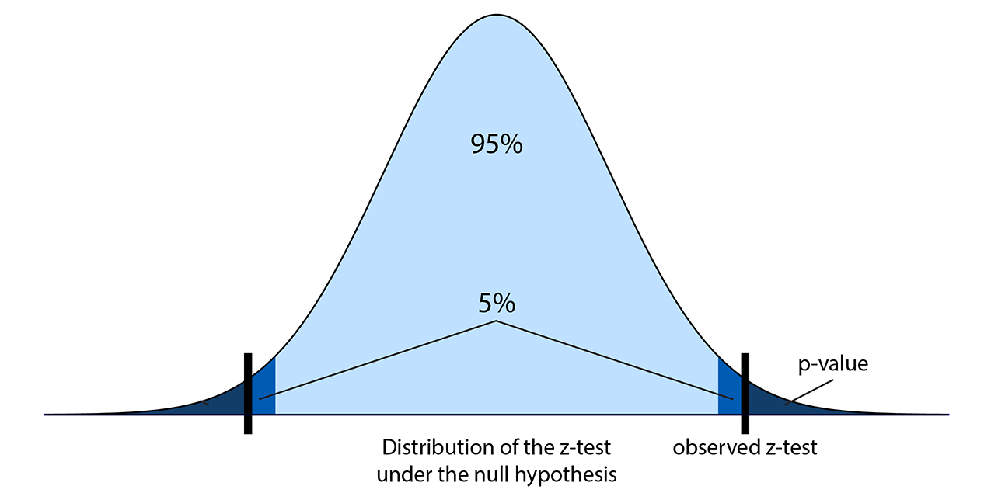
Class 4: Key steps for hypothesis testing
Steps:
State Null (H₀) and Alternate (H_{A}) hypothesis
State type of test – One tail, two tail
Decision criteria/level of significance of test – This defines the critical region
Test statistic computation
(X – mu)*sqrt(N)/std dev
X is sample statistic value, mu is pop mean, N is sample size, std-dev is sample std dev
Communicate decision
The decision to retain the null hypothesis could be correct.
The decision to retain the null hypothesis could be incorrect, it is know as Type II error.
The decision to reject the null hypothesis could be correct.
The decision to reject the null hypothesis could be incorrect, it is known as Type I error.

Slide 9
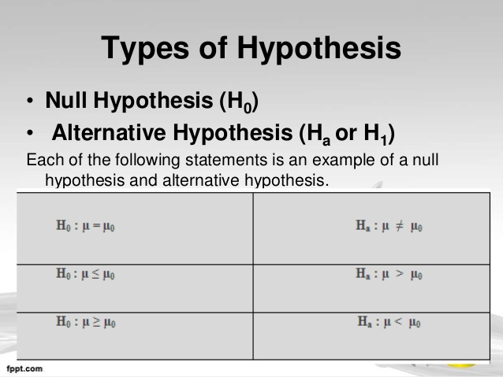
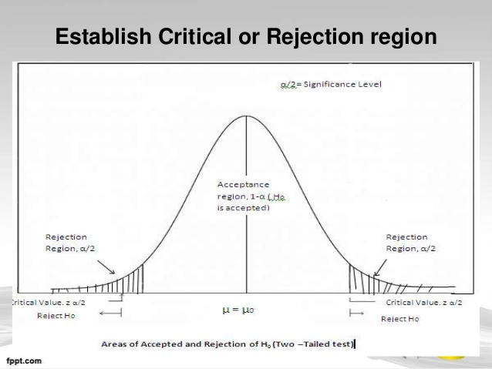
Class 4: Types of hypothesis, Critical region, One tail vs two tail and choice of statistic
If the null hypothesis is of the form x != y; without any sense of direction (greater or lesser) then we are dealing with two tailed tests; else one tail depending on what is being asserted
https://www.slideshare.net/piyushdhaker/hypothesis-testing-ppt-final

Slide 10
Class 4: Types of hypothesis, Critical region, One tail vs two tail and choice of statistic
Choice of test statistic depends on the number of sample involved in the study, measurement scale (nominal, ordinal, interval, ratio)
Choice of probability distributions of test statistic is dependent on sample size (N)
Sample Size | Population std dev
 | Known | unknown
N > 30 | Normal distribution | Normal distribution
N <30 | Normal distribution | T-distribution** (Norm dist is special case of t dist)
https://www.slideshare.net/piyushdhaker/hypothesis-testing-ppt-final

Slide 11
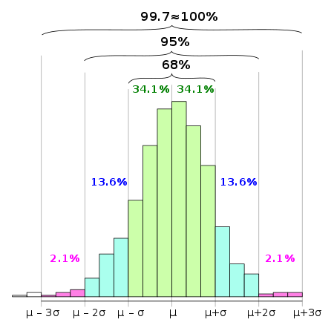
Class 4: 68–95–99.7 rule for Normal distribution
In statistics, the 68–95–99.7 rule is a shorthand used to remember the percentage of values that lie within a band around the mean in a normal distribution with a width of two, four and six standard deviations, respectively; more accurately, 68.27%, 95.45% and 99.73% of the values lie within one, two and three standard deviations of the mean, respectively. In mathematical notation, these facts can be expressed as follows, where X is an observation from a normally distributed random variable, μ is the mean of the distribution, and σ is its standard deviation
http://pro.arcgis.com/en/pro-app/tool-reference/spatial-statistics/what-is-a-z-score-what-is-a-p-value.htm

Slide 12
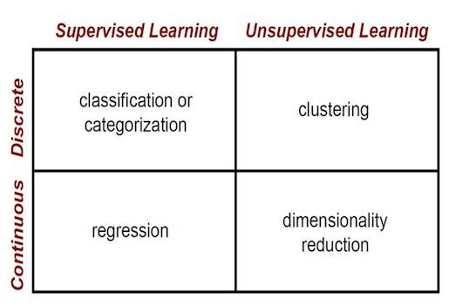
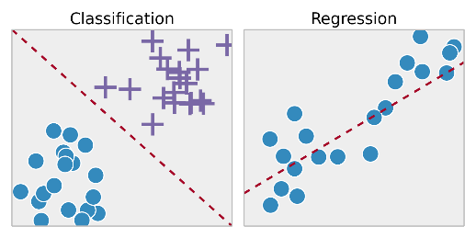
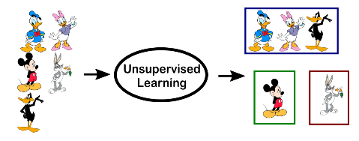
Class 4: Supervised vs. Un-supervised learning
In Machine learning, there are majorly 2 types of tasks/models.
Supervised learning models: Predicting the target variable, given we have labels in the training data.
Supervised learning is typically done in the context of classification, when we want to map input to output labels, or regression, when we want to map input to a continuous output.
Unsupervised learning: When we want to understand the structure of the dataset, goes without saying there are no labels available to us. We have to generate labels.
The main difference between the two types is that supervised learning is done using a ground truth, or in other words, we have prior knowledge of what the output values for our samples should be. Therefore, the goal of supervised learning is to learn a function that, given a sample of data and desired outputs, best approximates the relationship between input and output observable in the data.
Unsupervised learning, on the other hand, does not have labeled outputs, so its goal is to infer the natural structure present within a set of data points. The most common tasks within unsupervised learning are clustering, representation learning, and density estimation.
https://towardsdatascience.com/supervised-vs-unsupervised-learning-14f68e32ea8d

Slide 13
Class 4: Supervised vs. Un-supervised learning
Supervised Learning Models
Un-supervised learning models
Linear Regression
k-means/k-medoids/k-modes
Generalized Regressions
Association rules
Lasso/Ridge/Regularized Regression
Auto encoders (Neural nets)
Logistic Regression
Gaussian Mixture models
SVM
Latent class clustering
Random Forest
SVD/PCA/Factor Analysis
Neural Network classification/regression
Generative Adversarial Networks (GANs)

Slide 14
Class 4: Loss functions are the functions that help us understand the ‘error’ associated with predictions and tune our models. When summed over the entire training set we call it Cost function
Continuous target variable
Categorical target variable
MAPE / MAE
Cross entropy
RMSE/MSE
Hinge loss

Slide 15
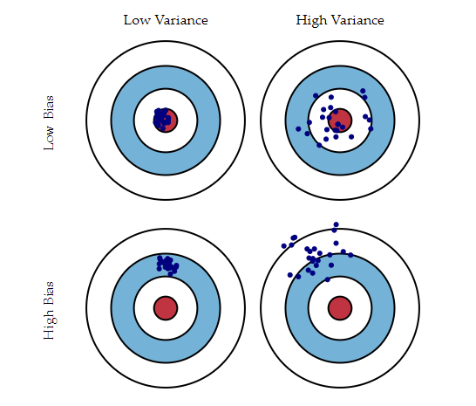
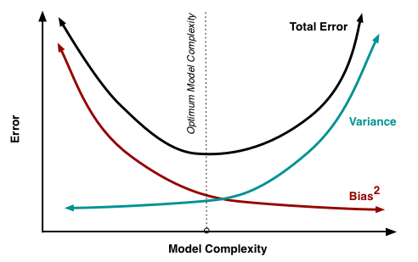
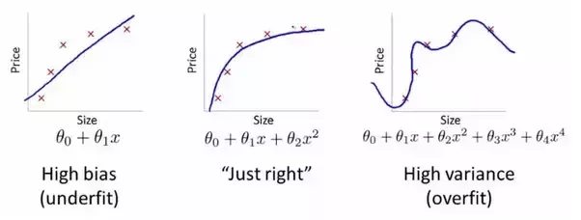
Class 4: Bias & Variance
Error due to Bias/Underfitting: The error due to bias is taken as the difference between the expected (or average) prediction of our model and the correct value which we are trying to predict. Of course you only have one model so talking about expected or average prediction values might seem a little strange. However, imagine you could repeat the whole model building process more than once: each time you gather new data and run a new analysis creating a new model. Due to randomness in the underlying data sets, the resulting models will have a range of predictions. Bias measures how far off in general these models' predictions are from the correct value.
Examples of high-bias machine learning algorithms include: Linear Regression, Linear Discriminant Analysis and Logistic Regression.
Examples of low-bias machine learning algorithms include: Decision Trees, k-Nearest Neighbors and Support Vector Machines.
Error due to Variance/Overfitting: The error due to variance is taken as the variability of a model prediction for a given data point. Again, imagine you can repeat the entire model building process multiple times. The variance is how much the predictions for a given point vary between different realizations of the model.
Examples of high-variance machine learning algorithms include: Decision Trees, k-Nearest Neighbors and Support Vector Machines.
Examples of low-variance machine learning algorithms include: Linear Regression, Linear Discriminant Analysis and Logistic Regression.
http://scott.fortmann-roe.com/docs/BiasVariance.html

Slide 16
Class 4: Missing data analysis
Missing data can be due to various reasons:
MAR (Missing at Random): Cause of the missing data is unrelated to the missing values but may be related to the observed values of other variables.
Eg: missing income data may be unrelated to the actual income values but are related to education.
Perhaps people with more education are less likely to reveal their income than those with less education
MCAR (Missing completely at random): Missing data mechanism is unrelated to the values of any variables, whether missing or observed. These cases can be imputed.
Non-Ignorable (NI): NI means that the missing data mechanism is related to the missing values. There are most problematic and should not be imputed.
Listwise deletion: Delete rows with missing data
Column wise deletion: Delete rows with missing data if a majority of data points of that column are missing
Imputations:
Mean Imputation: Replace value with mean value. Mostly for continuous variables
Median Imputation: Replace with Median. Mostly for categorical
Mode Imputation: Replace with Mode. Mostly for categorical
Target Encoding – Advanced. Encode missing value with target mean value. Very easy to over-fit and we do this k-fold way.
Expectation Maximization: We will not cover this, but this is based on EM algorithm heuristic

Slide 17



Class 4: Linear Algebra - Vectors
Vectors: A 1 D dataframe can be thought of an Vector; similar to an numpy array. However, there are many operations we can do with vectors. Vectors are “things” that have both a magnitude and a direction.
Operations: Dot product, distance measures, multiply with matrix
Ex: V = {x1,x2}
Magnitude =
If Magnitude = 1, then unit vector
$$\sqrt{x_{1}^{2}+x_{2}^{2}}$$
(2,2)
Magnitude: sqrt(8)
$$θ \left(Angle \right)$$
https://web.stanford.edu/class/cs231a/section/section1.pdf

Slide 18
Class 4: Linear Algebra - Vectors
Let:
V = {V1,V2}
U = {U1, U2}
Addition:
V+U = {V1+U2, V2+U2}
Subtraction:
V-U = {V1-U2, V2-U2}
Multiplication by a scalar:
aV = {aV1,aV2}
https://web.stanford.edu/class/cs231a/section/section1.pdf

Slide 19
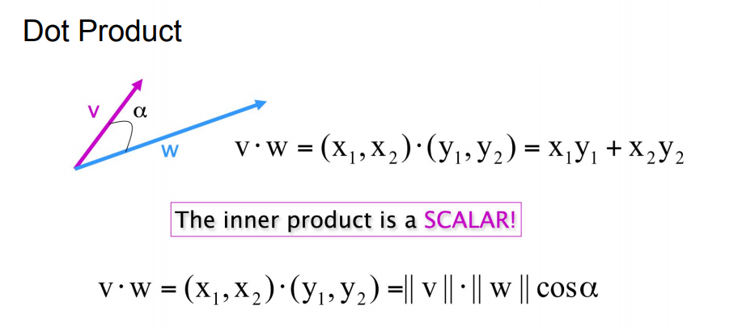
Class 4: Linear Algebra - Vectors
We usually use dot product to get the value of alpha specifically cos($α) ;$which is a measure of similarity of two vectors.
https://web.stanford.edu/class/cs231a/section/section1.pdf

Slide 20
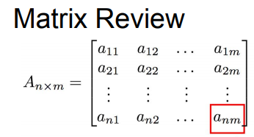
Class 4: Linear Algebra - Matrix
Matrix: A dataframe like object, with homogeneous data types is a matrix
Operations: Dot product, matrix multiplication, factorization, transpose, determinant,inverse etc
https://web.stanford.edu/class/cs231a/section/section1.pdf

Slide 21
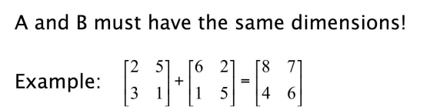
Class 4: Linear Algebra - Matrix
Sum – Element wise sum:
c_{ij} = a_{ij} + b_{ij}
Similarly for subtraction
https://web.stanford.edu/class/cs231a/section/section1.pdf

Slide 22
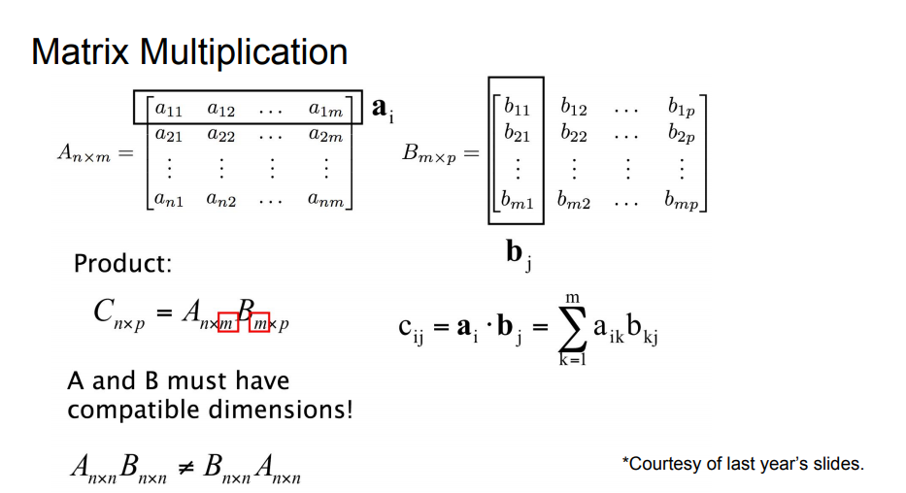
Class 4: Linear Algebra - Matrix
https://web.stanford.edu/class/cs231a/section/section1.pdf

Slide 23
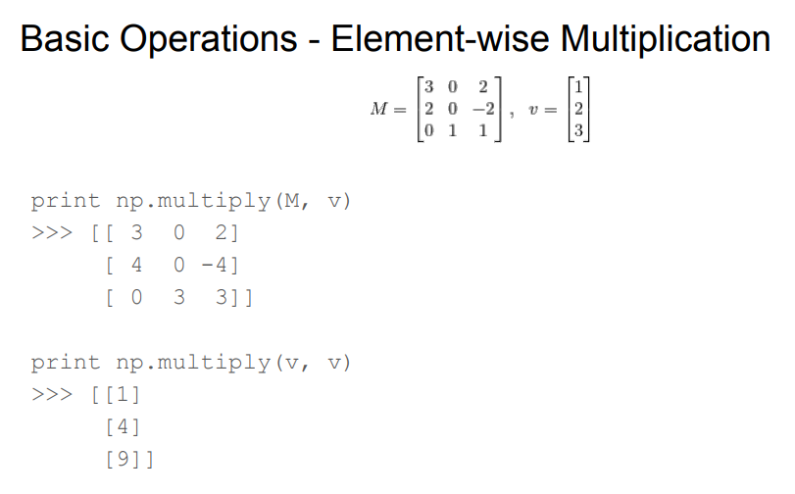
Class 4: Linear Algebra - Matrix
Matrix multiplication is implemented in python via A.dot(B)
https://web.stanford.edu/class/cs231a/section/section1.pdf

Slide 24
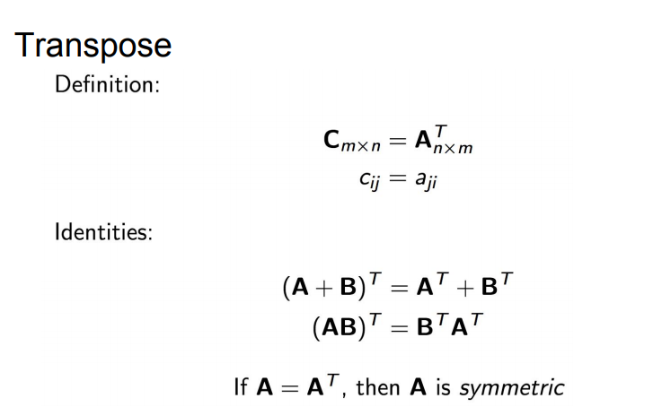
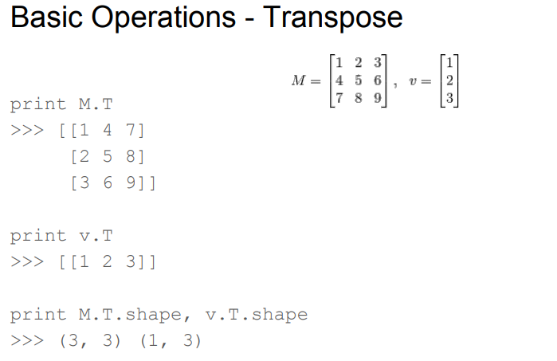
Class 4: Linear Algebra - Matrix
https://web.stanford.edu/class/cs231a/section/section1.pdf

Slide 25
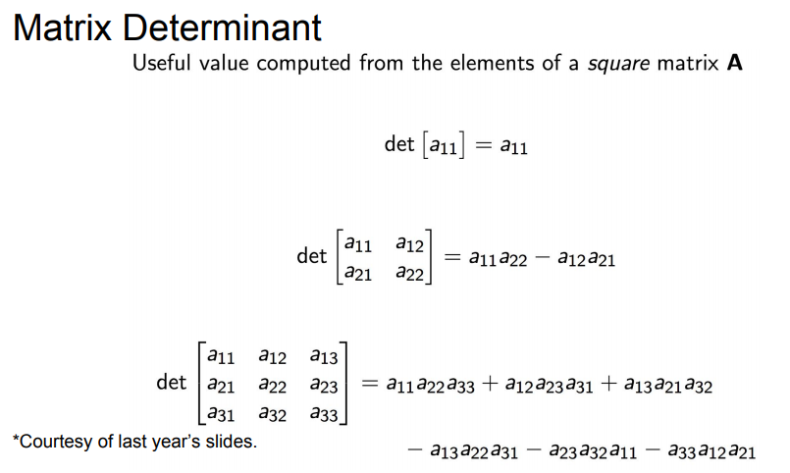
Class 4: Linear Algebra - Matrix
https://web.stanford.edu/class/cs231a/section/section1.pdf

Slide 26
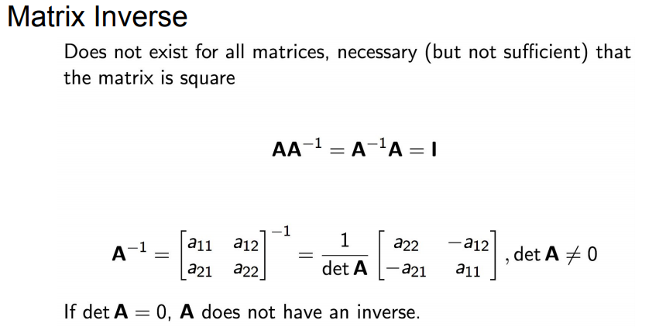
Class 4: Linear Algebra - Matrix
https://web.stanford.edu/class/cs231a/section/section1.pdf

Slide 27
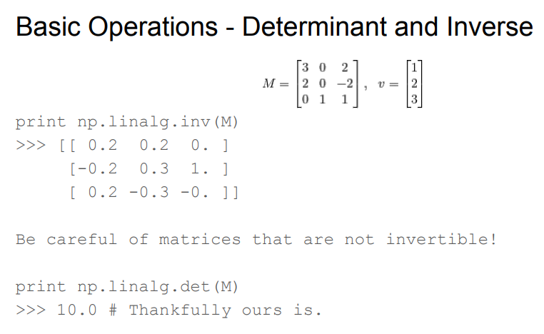
Class 4: Linear Algebra - Matrix
https://web.stanford.edu/class/cs231a/section/section1.pdf

